Slide 1
Unit 4

Slide 2
Unit 4 - Automation
PLC –
Basics, overview of PLC systems, PLC Architecture, latching and interlocking concept,
Evolution: DAS, SCADA, Introduction to DCS and its architecture,
example of continuous control and logic control.

Slide 3
PLC
Programmable Logic controllers

Slide 4
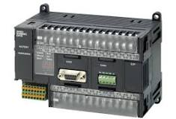
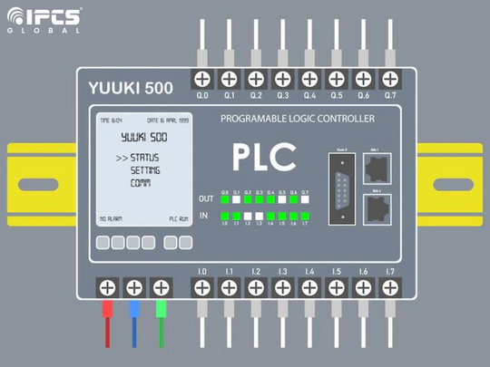
PLC
PROGRAMMABLE LOGIC CONTROLLER..

Slide 5
What is PLC..
PLC is a user friendly microprocessor based specialized computer that carries out control functions of many types and levels of complexity.
Its purpose is to monitor crucial process parameters & adjust process operations accordingly.
Used extensively…because…
It is easy to setup & program
Behaves predictably
Ruggedized

Slide 6
PLCs….
PLCs are the most widely used industrial process control technology..
A (PLC) is an industrial grade computer that is capable of being programmed to perform control functions.
The programmable controller has eliminated much of the hardwiring associated with conventional relay control circuits……
Other benefits include easy programming and installation, high control speed, network compatibility, troubleshooting and testing convenience and high reliability…

Slide 7
PLCs….
It can be programmed (to a degree), controlled & operated by a person unskilled in programming computers..
Essentially, a PLC’s operator draw the lines... and devices of a ladder diagram with a keyboard/mouse onto a digital screen
The resulting LD is converted into computer machine language and run as a program..

Slide 8
Need of PLCs
Initially the PLC was used to replace relay logic, but its………… ever-increasing range of functions means that it is found in many and more complex applications.
Because the structure of a PLC is based on the same principles as those employed in computer architecture, it is capable not only of performing relay switching tasks but also of performing other applications such as timing, counting, calculating, comparing, and the processing of analog signals.

Slide 9
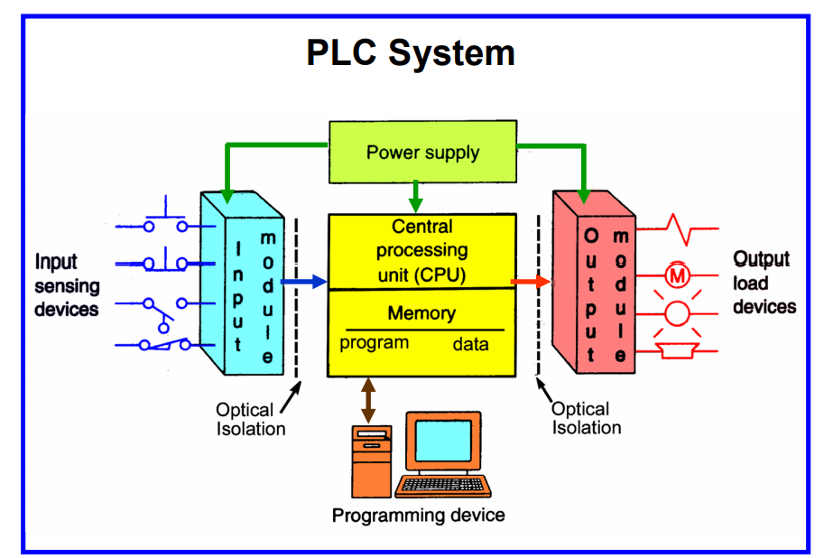

Slide 10
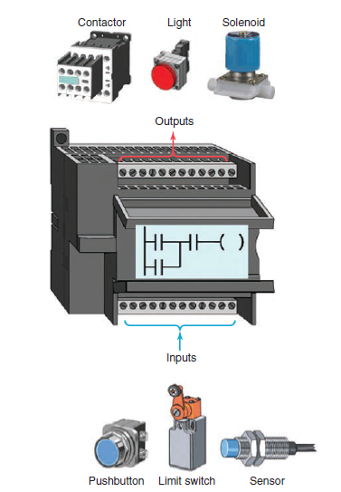
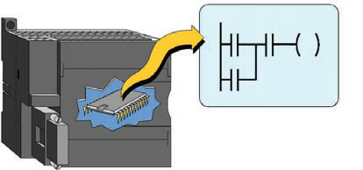
What are PLC
All the logic is contained in the PLC’s memory.
Relationships between the inputs and outputs are determined by the user program.

Slide 11
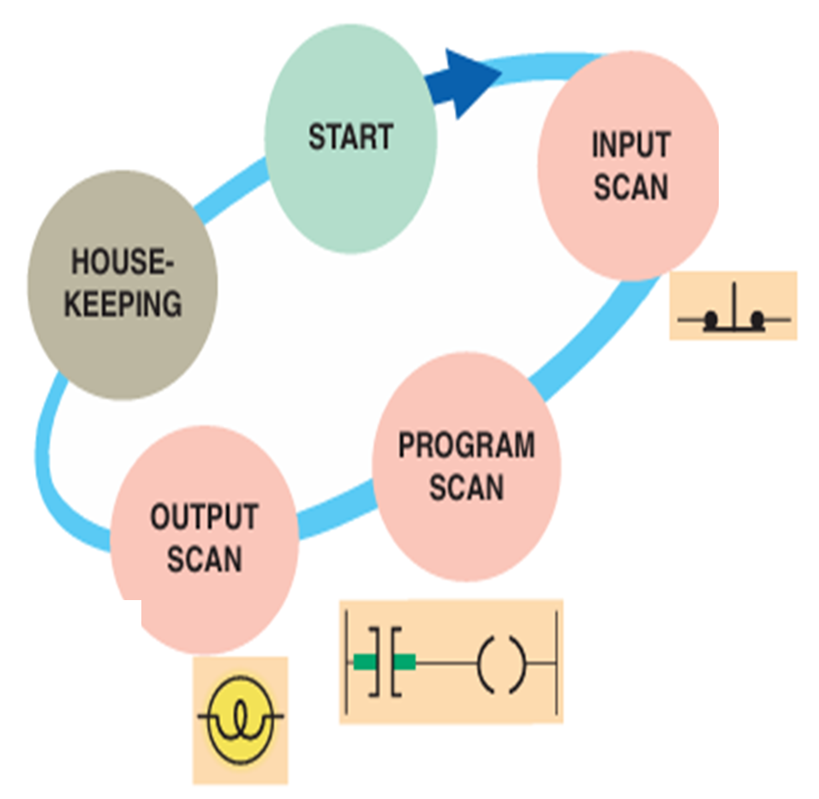
PLC- SCAN PROCESS
The status of external inputs is written to the input image table(file or register)
Internal checks on memory, speed & operation.
Service any commn. Requests…
Each ladder rung is scanned & solved using the data in the I/P file. The resulting logic is written to the output image table(file or register)
The O/P image data is transferred to the external O/P circuits, turning the O/P device ON or OFF.

Slide 12
PLC …ADVANTAGES..
Increased Reliability
More Flexibility
Lower cost
Pilot running
Visual observation
Communication capabilities
Faster response time.
Easier to troubleshoot
….

Slide 13
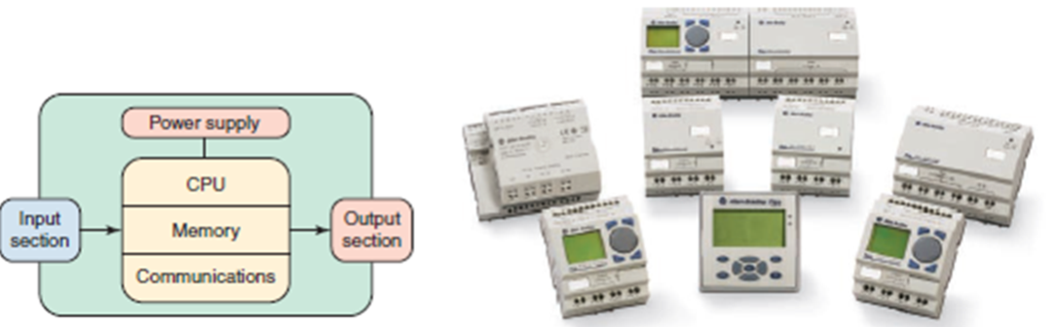
Fixed type

Slide 14
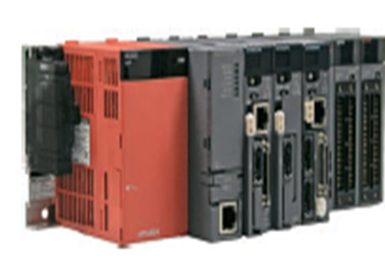
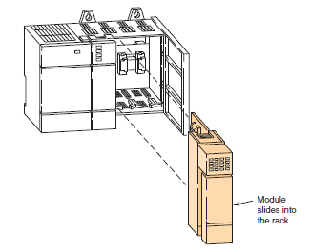
Modular type

Slide 15
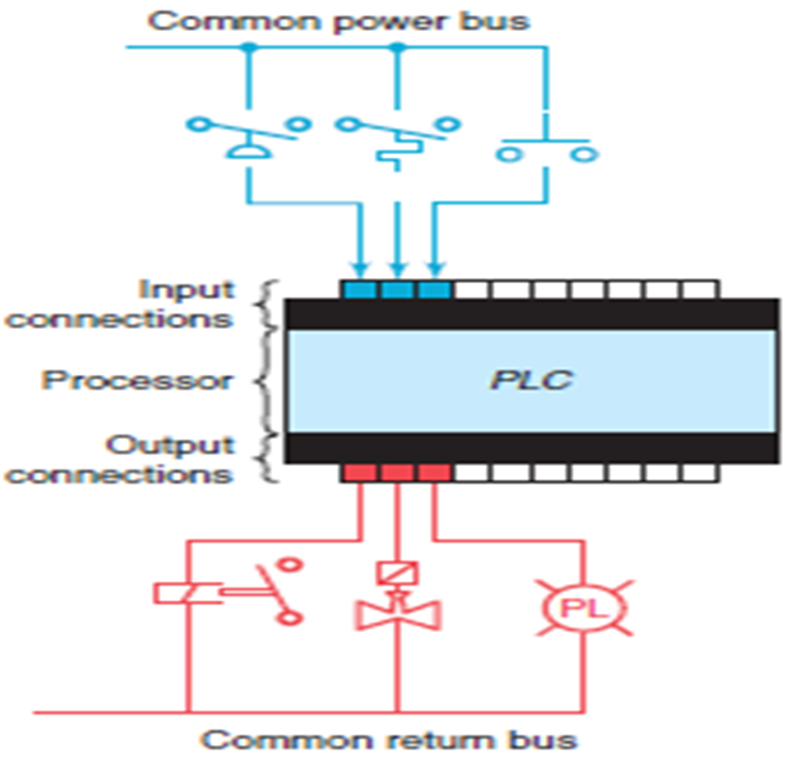

Slide 16
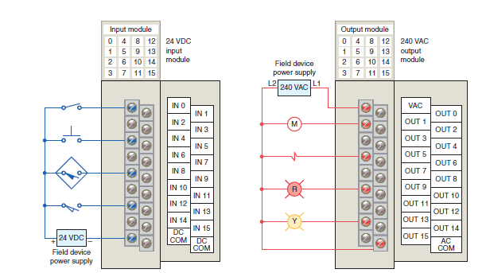
Typical PLC Input / Output (I/O) system connections

Slide 17
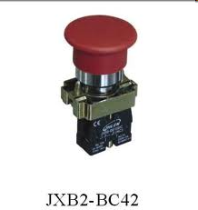
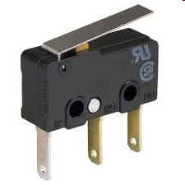
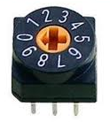
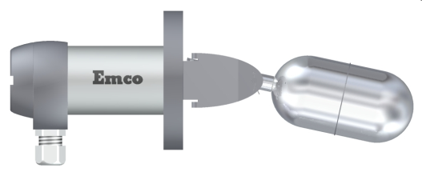
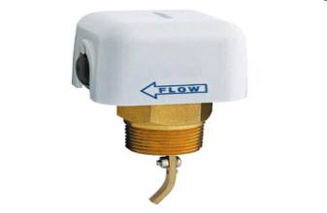
INPUT DEVICES:
Push Button
Limit Switch
Thumbwheel SW
Level SW
Flow SW

Slide 18
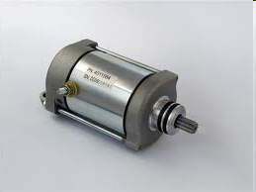
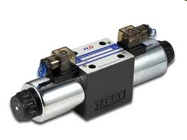
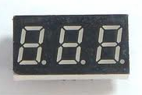
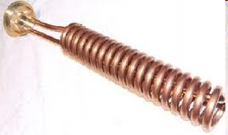
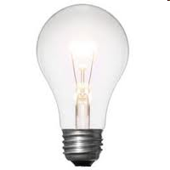
OUTPUT DEVICES:
Motor
Solenoid
LED Display
Heater Coil
Lamp

